Slide 1
Research Ethics
Matthew Billington
0151 794 8290
ethics@Liverpool.ac.uk
www.liverpool.ac.uk/intranet/research-support-office/research-ethics/

Slide 2
Research Ethics?
Research Ethics is a world-wide set of principles governing the way any research involving interaction between the researcher and other humans or human tissue or data relating to humans, is designed, managed and conducted. In preparing a research project, the dignity, rights, safety and well-being of human participants must at all times be considered, respected and safeguarded.
Research Ethics The application of moral rules and professional codes of conduct to the collection, analysis, reporting, and publication of information about research subjects, in particular active acceptance of subjects' right to privacy, confidentiality, and informed consent.

Slide 3
Research Ethics at University of Liverpool
ALL research involving human participants, animals, their tissues or data (which, in addition to experimental and quantitative data, can include qualitative (descriptive) data, transcripts of interviews, etc.) MUST have ethical approval from a University of Liverpool-recognised research ethics committee.
Research must not start prior to ethical approval being obtained.
Retrospective approval cannot be given.
Why
Respecting the rights and dignity of human participants
Legal frameworks and policies e.g. Data Protection Act, consent;
Practicalities of reducing risk
Protection
Funders
Creates better research
Research that results in benefits and has minimal risk of harm is research that has been carried out in an ethical manner.

Slide 4
Research Ethics at University of Liverpool
Research ethics approval is not required for:
Research which does not involve human participants, their data/tissues (literature analysis).
Secondary analysis of non-identifiable information.
Secondary analysis of information freely available in the public domain.

Slide 5
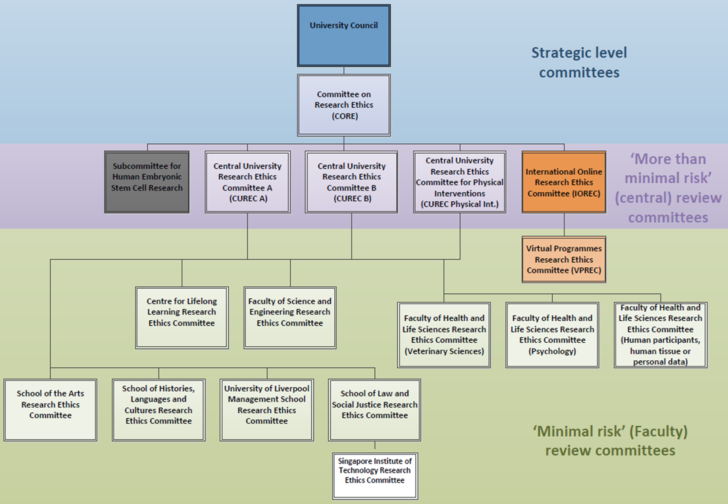

Slide 6
Consent
Consent is the central act in research ethics, in accordance with the University’s key principles, researchers should ensure that every person from whom data is collected for the purpose of research, consents freely to the process on the basis of adequate information. Participants should also be made aware that they are free to withdraw or modify their consent at any point of the research taking place.
Research staff and participants must be informed fully about the purpose, methods and intended possible uses of the research, what their participation in the research entails and what risks, if any, are involved.
Step 1: The giving of information
Step 2: The discussion, clarification and review of the information
Step 3: Obtaining the person's written and/or verbal consent

Slide 7
Confidentiality
The confidentiality of information supplied by research participants and the anonymity of respondents must be respected.
When one person discloses personal information to another believing that it will be held in confidence, a duty of confidence and trust is created.
'The appropriate use and protection of patient data are also paramount. All those involved in research must be aware of their legal and ethical duties. Particular attention must be given to systems for ensuring confidentiality of personal information and to the security of those systems'.
Providing anonymity wherever possible
Safe storage of the data
Restricting access to the research team

Slide 8
Risk
Research proposals should be considered in the context of the risks of the project, this can be defined as the potential physical or psychological harm or stress to the participant or the researcher. When considering a research project the benefits needs to be maximised and the risks minimised. Risks and benefits should be explained to participant as part of the informed consent process.
Psychological Harm
Physical Harm
Legal Harm
Social and Economic Harm
How to minimise risk
Researchers can minimise the risk of a study by implementing research that includes a well informed protocol, assemble a research team with sufficient expertise, incorporate adequate safeguards, ensure participants autonomy is maximised and ensure the benefits are maximised. A well documented risk assessment should establish that the risks of your research are minimised.

Slide 9
Example Application
Staff Project from the Institute of Psychology, Health and Society, which came to full committee review last year.
Flagged to central full committee- interview/sensitive

Slide 10
Research Aims and Designs
The research involved investigating drinking behaviours following periods of absence from drinking (e.g. Dry January)
The researchers proposed to provide participants with a breathalyser and a smartphone app in order to record drinking behaviours. A questionnaire would then be administered to review the participant’s perspectives against the data from the app.

Slide 11
Informed Consent
The committee requested further information on how the consent process would look for the questionnaire element
The committee recommended that a welcome page was added to the questionnaire which provided information on the study; and contained a consent box through which the participants could tick in order to access the rest of the questionnaire

Slide 12
Confidentiality
The researchers originally proposed to make photocopies of participant's ID’s/ passports for verification purposes as part of the breathalyser element of the study.
The committee felt that this was unnecessarily collecting identifiable data which could later compromise confidentiality and anonymity. The researchers modified the research design to take a digital photograph of each participant.

Slide 13
Data Management
The committee were concerned regarding the proposal to send breathalyser data to the USA from participant’s mobile phones.
The researchers made modifications to the proposals so that all participants were loaned a mobile phone with the app downloaded, meaning no identifiable information was being transmitted.

Slide 14
Risk
The Committee recommended that as the study had the potential to cause distress to participants, a debrief sheet should be produced to provide further guidance and support resources to participants.
The committee also suggested that the researchers prepare a procedure for managing participant distress.
The researchers were asked to provide a lone worker risk assessment to cover the interviews which involved the researchers working alone with participants.

