Slide 1
Research ethics
Matthew Billington
Research Ethics and Integrity Officer
September 2017

Slide 2
Structure
Introduction to research ethics
Principles of research ethics
University policies and procedures
Online system for research ethics applications
Conclusion and key points

Slide 3
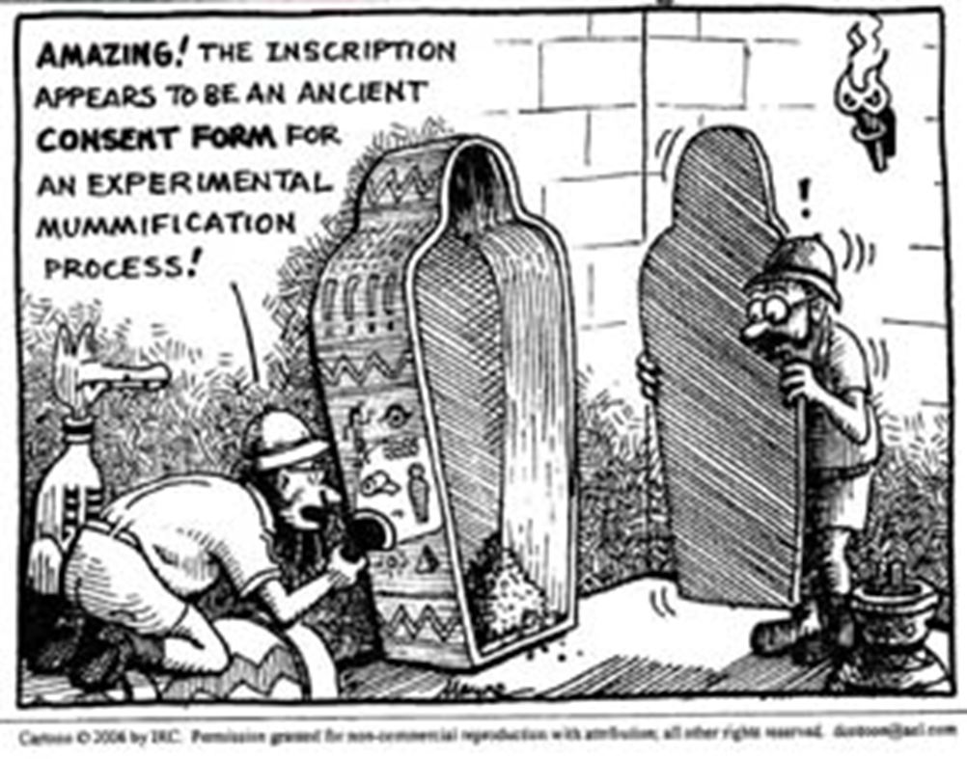
“Research ethics”

Slide 4
Research Ethics: key principles
Autonomy: The participant must normally be as aware as possible of what the research is for and be free to take part in it without coercion or penalty for not taking part, and also free to withdraw at any time without giving a reason and without a threat of any adverse effect.
Beneficence: The research must be worthwhile in itself and have beneficial effects that outweigh any risks; it follows that the methodology must be sound so that best results will be yielded.
Non maleficence: Any possible harm must be avoided or at least mitigated by robust precautions.
Confidentiality: Personal data must remain unknown to all but the research team (unless the participant agrees otherwise or in cases where there is an overriding public interest, or where participants wish their voices to be heard and identified).
Integrity: The researcher must be open about any actual or potential conflicts of interest,

Slide 5
Informed consent
Research staff and participants must be informed fully about the purpose, methods and intended possible uses of the research, what their participation in the research entails and what risks, if any, are involved.
Step 1: The giving of information
Step 2: The discussion, clarification and review of the information
Step 3: Obtaining the person's written and/or verbal consent

Slide 6
Informed Consent: practicalities
Consent forms and information sheets
Clarity and full description of key aspects of their participation study
Period of reflection

Slide 7
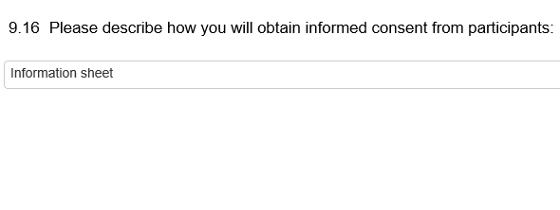

Slide 10
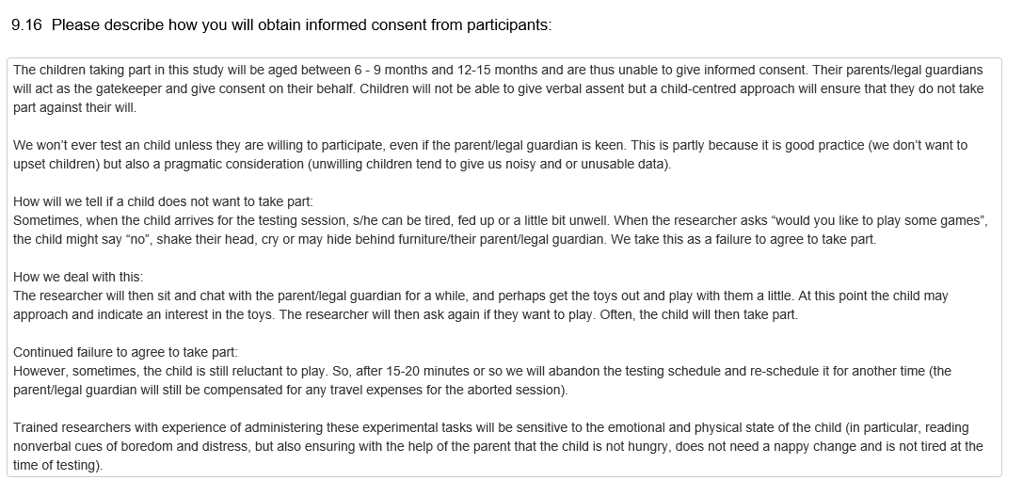

Slide 11
Informed consent: Scenarios
How might the approach to consent differ if the study involves children?
What are the challenges of obtaining informed consent from participants who have a direct relationship with the researcher?

Slide 12
Confidentiality
The confidentiality of information supplied by research participants and the anonymity of respondents must be respected.
When one person discloses personal information to another believing that it will be held in confidence, a duty of confidence and trust is created.
'The appropriate use and protection of patient data are also paramount. All those involved in research must be aware of their legal and ethical duties. Particular attention must be given to systems for ensuring confidentiality of personal information and to the security of those systems'.

Slide 13
Confidentiality: practicalities
Providing anonymity wherever possible
Safe storage of the data
Restricting access to the research team

Slide 17
Confidentiality: Scenarios
Are there any circumstances whereby the nature of the information revealed during the research may impact upon the duty of confidentiality?
What challenges does interviewing people in public roles pose for the principle of anonymity?

Slide 18
Emerging issues
General Data Protection Regulations
Open data
Online research

Slide 19
Internet-mediated research
UK Research Integrity Office Good Practice in Research: Internet mediated research
Association of internet researchers: Ethical Decision-Making and Internet Research
Dr Leanne Townsend: Social Media and Research Ethics
British Psychological Society: Ethics Guidelines for Internet-mediated Research

Slide 20
University policies and procedures
University policy on research ethics
University review process
Specific review procedures

Slide 21
When is research ethics review required?
All research involving human participants, their tissues or data must have ethical approval from a research ethics committee.
Research must not start prior to ethical approval being obtained.
Retrospective approval cannot be given.

Slide 22
When is ethical review not required?
Research ethics approval is not required for:
Research which does not involve human participants, their data/tissues (literature analysis).
Secondary analysis of non-identifiable information.
Secondary analysis of information freely available in the public domain.

Slide 23
University research ethics review process
Faculty review.
Central review.
Recognising an external ethics committee.
Amendment.

Slide 24
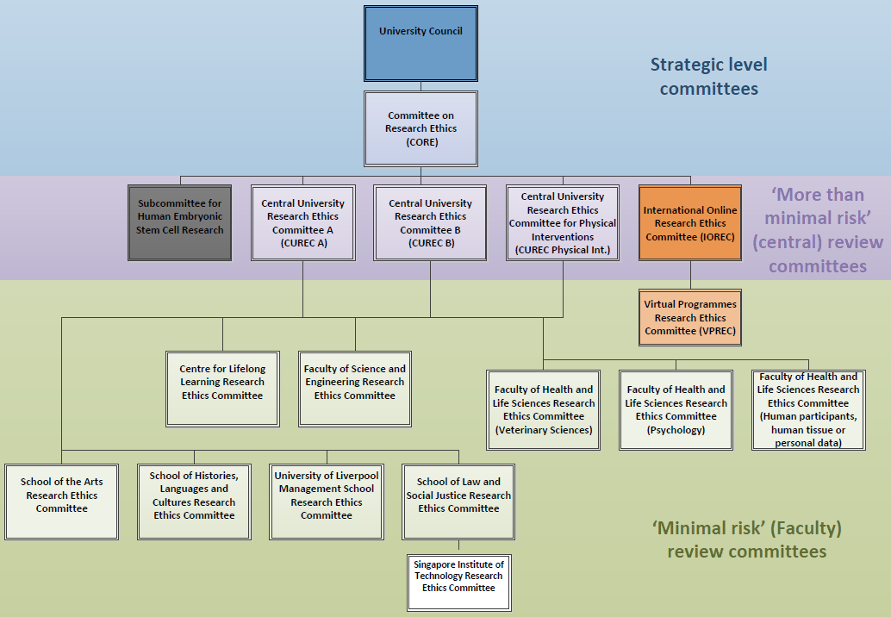

Slide 25
Relevant specific procedures
Undergraduate and taught postgraduate research policy
Series of studies

Slide 26
Before applying for ethical review
Further information on the application process can be found at: http://www.liv.ac.uk/research-integrity/.
Use any relevant guidelines.
Allow sufficient time for the review.
Use the form as a discussion forum.

Slide 27
What does a good research ethics application look like?
Evidence of engagement with the ethical considerations.
Use the form as a discussion forum.
Use any relevant guidelines.
Submit supporting material.

Slide 28
Avoiding common mistakes…
Applications with little detail provided.
Unclear description of the research.
“n/a” rather than explanatory sentences.
“There are no risks”.

Slide 29
Research ethics online system
Designed to encourage discussion of relevant issues
User guides

Slide 30
Resources
ESRC Framework for Research Ethics
http://www.esrc.ac.uk/funding/guidance-for-applicants/research-ethics/
University of Liverpool research ethics webpages
https://www.liv.ac.uk/intranet/research-support-office/research-ethics/

Slide 31
Research ethics contact details
Central research ethics and integrity team
Email: ethics@liverpool.ac.uk
Website: https://www.liv.ac.uk/researchethics

