Slide 1

Introduction
Thomas Gorry
@TGorry

Slide 2
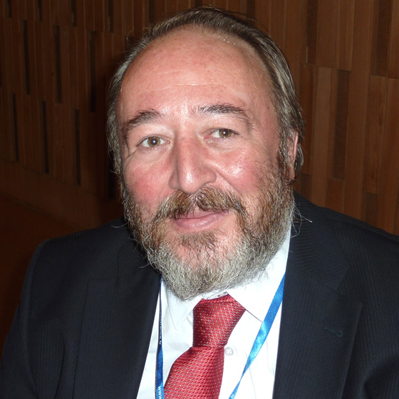
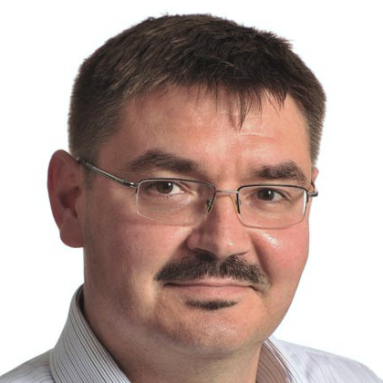

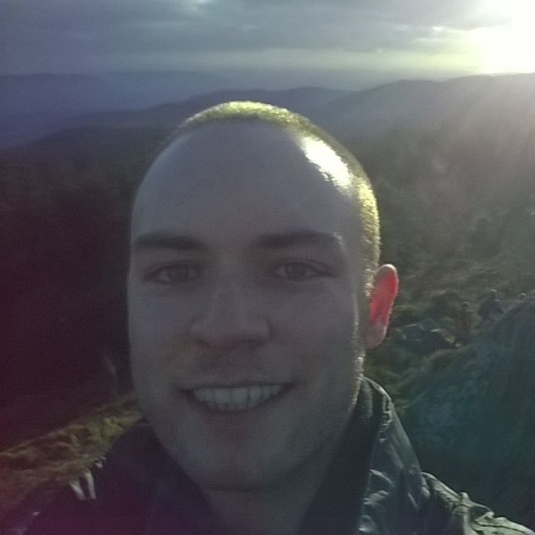
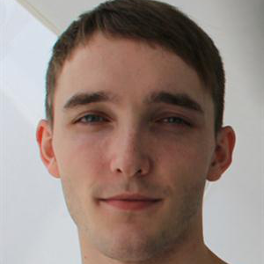
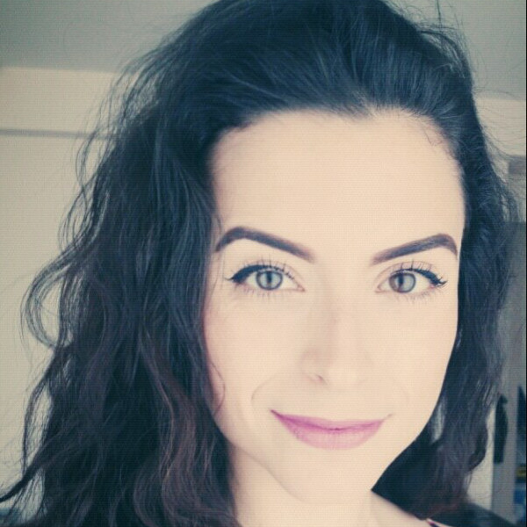
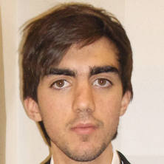
Who we are…
Paul Spirakas
P.Spirakis@Liverpool.ac.uk
Leszek Gasieniec
@LAGasieniec
Russell Martin
@Russ_A_M
Thomas Gorry
@TGorry
David Hamilton
@_ddhamilton
Eleni Akrida
@Nina_Akrida
Ashley Farrugia
AshleyFa@liverpool.ac.uk

Slide 3






What is this event?
Software Development
Static & Dynamic Data Analysis
Networking
Application Building
Having Fun!

Slide 4


What are the rules?

Slide 5




NeST Hackathon 2015 Rules
Must make use of the iTracs API.
Use any programming language you like.
Must use a GitHub repository so your code is available to everyone after the event.
Must showcase your application to be elligable for a prize.

Slide 6


Sponsors

Slide 7
Things to know...
Wireless: Please try and use Eduroam
Building Access
Food and Drink
Bathrooms

